Slide 1
Social digitization an alternative to a digital library
Witold Kozakiewicz
Library of Medical University of Lodz

Slide 2
WEB 2.0
Web 2.0 generally refers to a second generation of services available on the World Wide Web that lets people collaborate and share information online. In contrast to the first generation, Web 2.0 gives users an experience closer to desktop applications than the traditional static Web pages

Slide 3
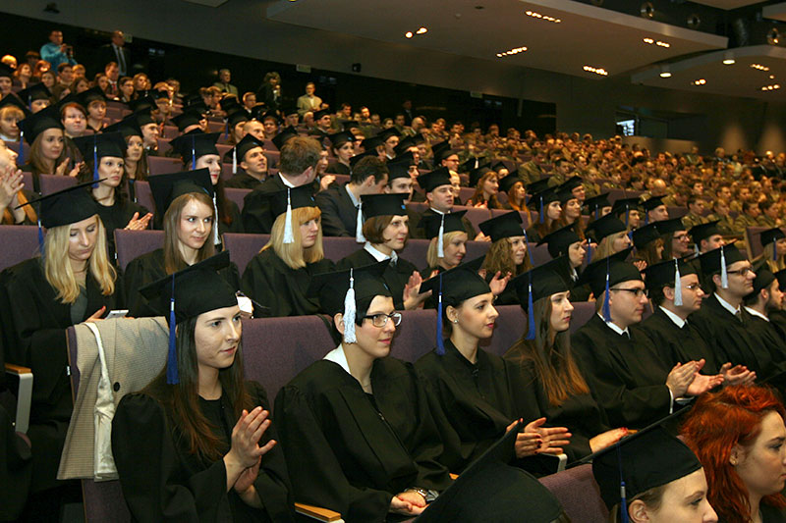
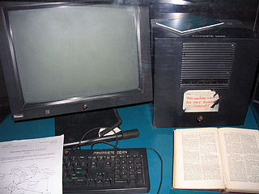
iGens–Born 1990s
Source: umed.pl
Source: Wikimedia Commons CC-BY-SA
Graduates 2013
First Web Server - 1989

Slide 4
Native users of digital technologies
Born in the 1990s this group of children is the first who cannot remember when they first used a computer.
Green, H. & Hannon, C. (2007) Their Space. Demos: http://www.demos.co.uk/publications/theirspace.

Slide 5
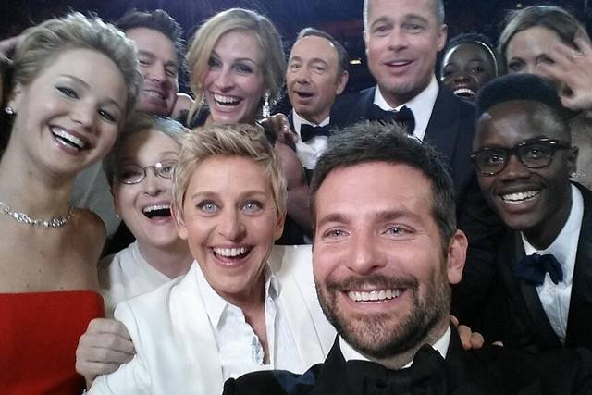
SHARE!!!
„Watching young people, we felt that sharing is an integral part of the reception and consumption of cultural content. They seemed as if the lack of opportunities to share their findings or achievements with their friends crossed out the possibility of full reception”
„Young and Media”

Slide 6
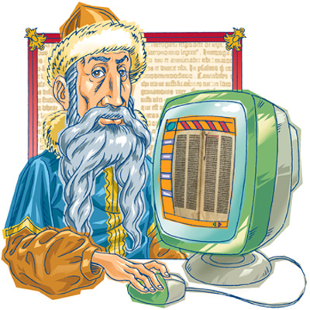
„Innovation”
Needs + Possibilities

Slide 7
Need: Handbooks
Possibility:
Bookstore
Library
Friends

Slide 8
Problems
Bookstore: too expensive, not available, out of print
Library– missing, damaged, borrowed, have to wait, have to go.
Friends – need the same books in the same time.

Slide 9
Solution
Digital Copy
Copy

Slide 10
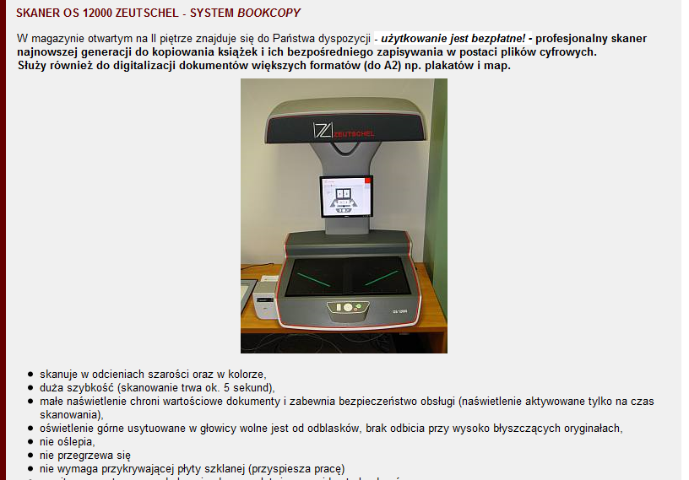
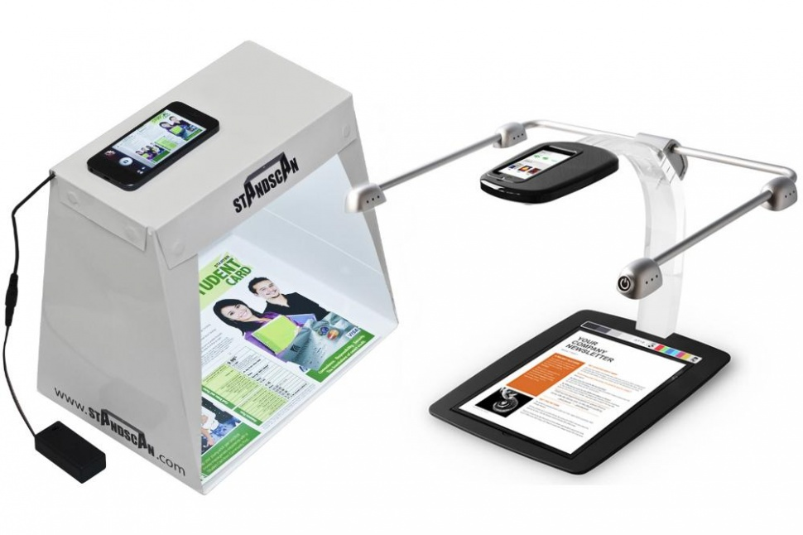
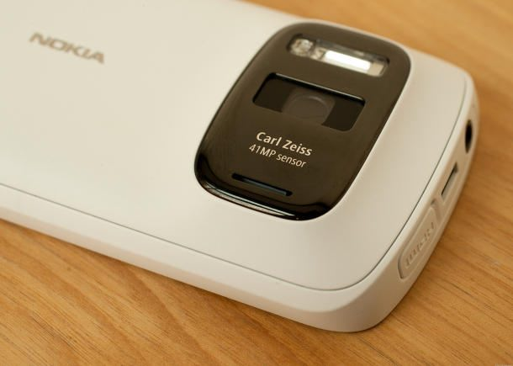
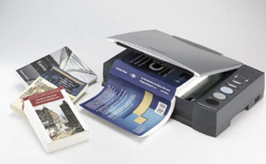
Digitize – it’s easy
Source: http://bg.p.lodz.pl/podst_uslug.htm#scanner_Z
http://www.digitaltrends.com/mobile/standscan-vs-scandock-smartphone-scanning/

Slide 11
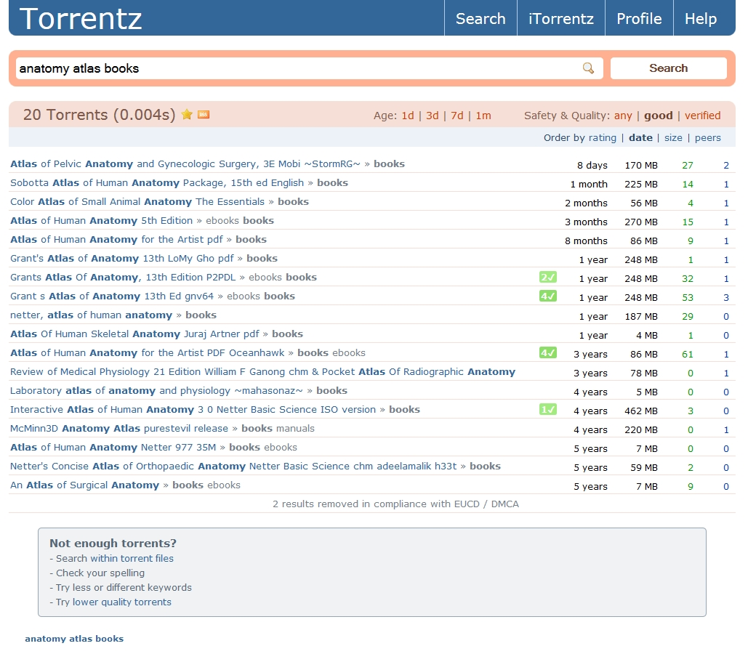
Share - P2P

Slide 12
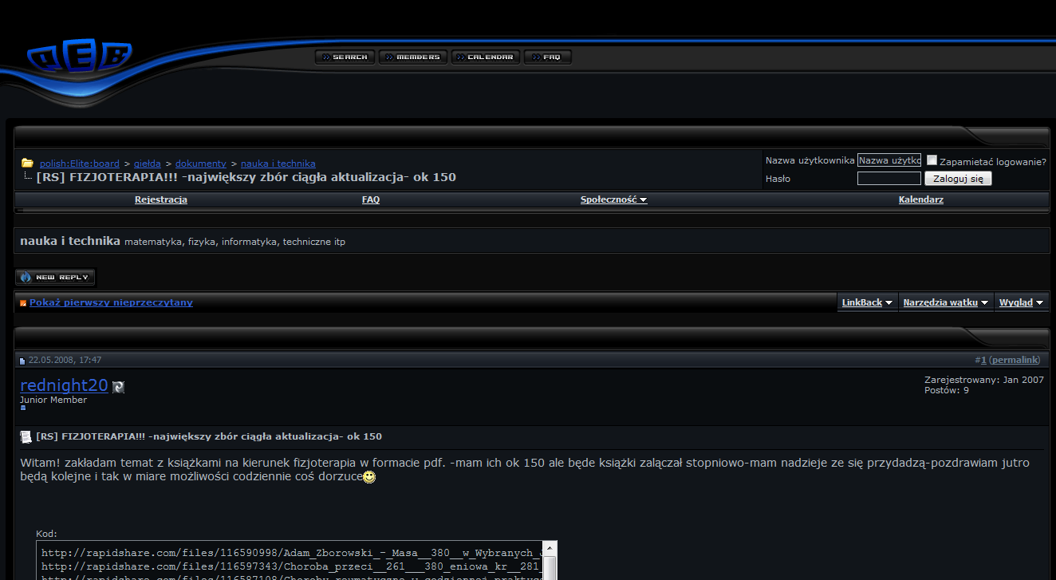
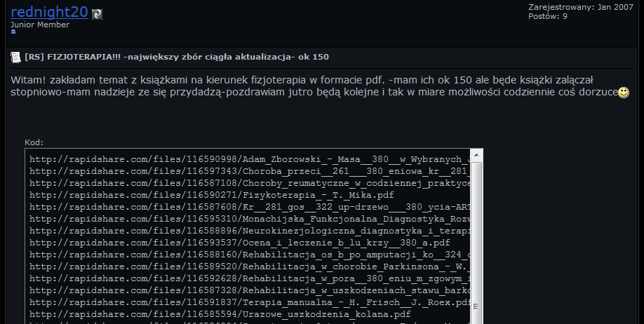
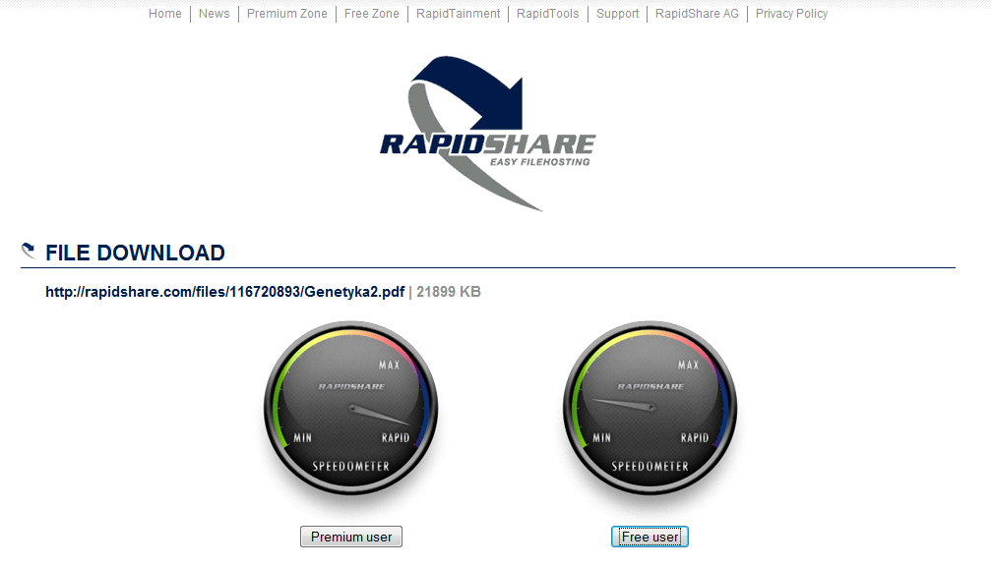
Share – Forums and Cloud disk

Slide 13
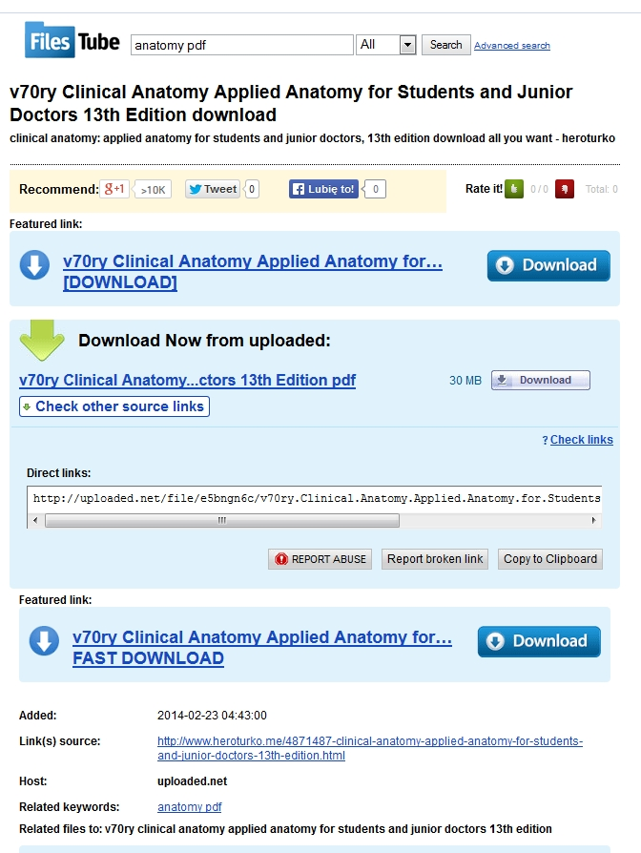
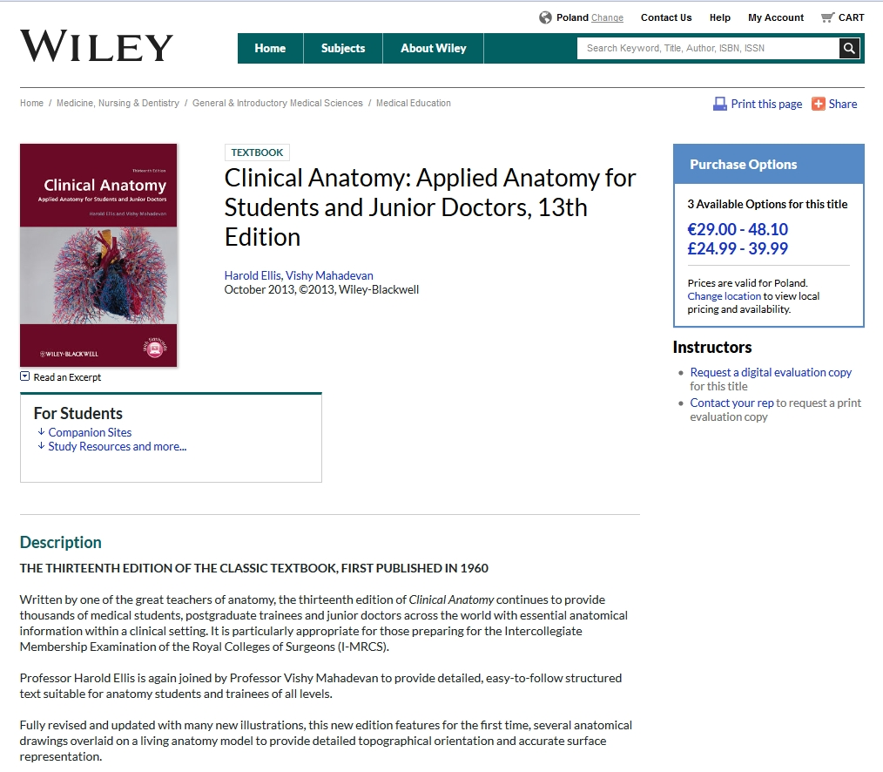
Search engines

Slide 14
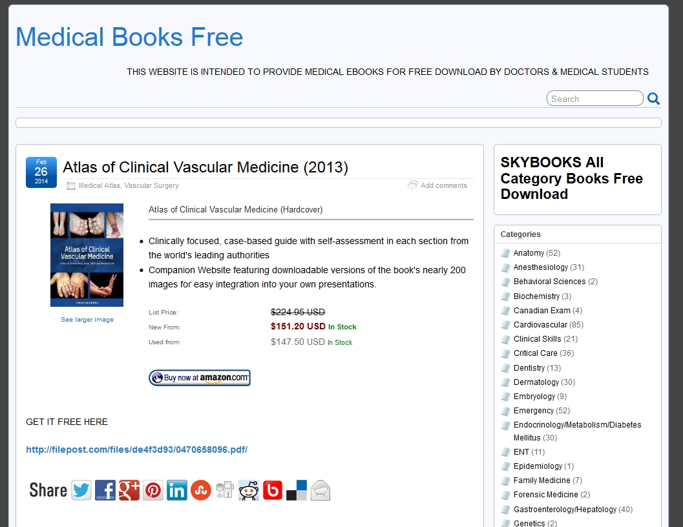
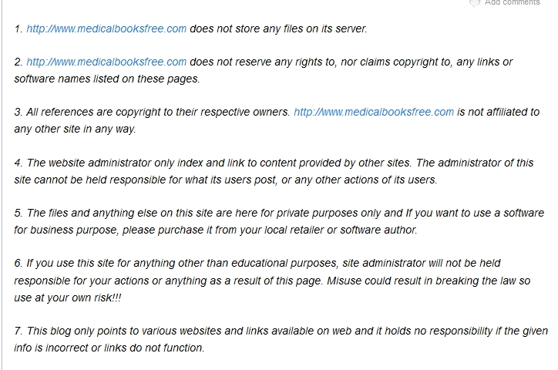
Dedicated websites Medical Books Free

Slide 15
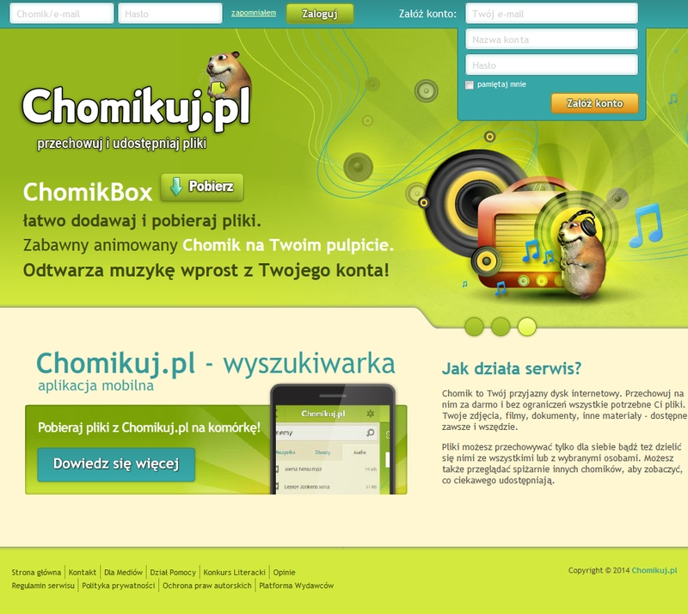
Hamster - chomikuj.pl
How it works:
Hamster your friendly online disk. Keep all of your files on it for free and without restrictions. Your photos, videos, documents and other materials - available anytime, anywhere. Files can be stored only for yourself or shared with everyone or selected users. You can also view other hamsters pantries to see what interesting they share.

Slide 16
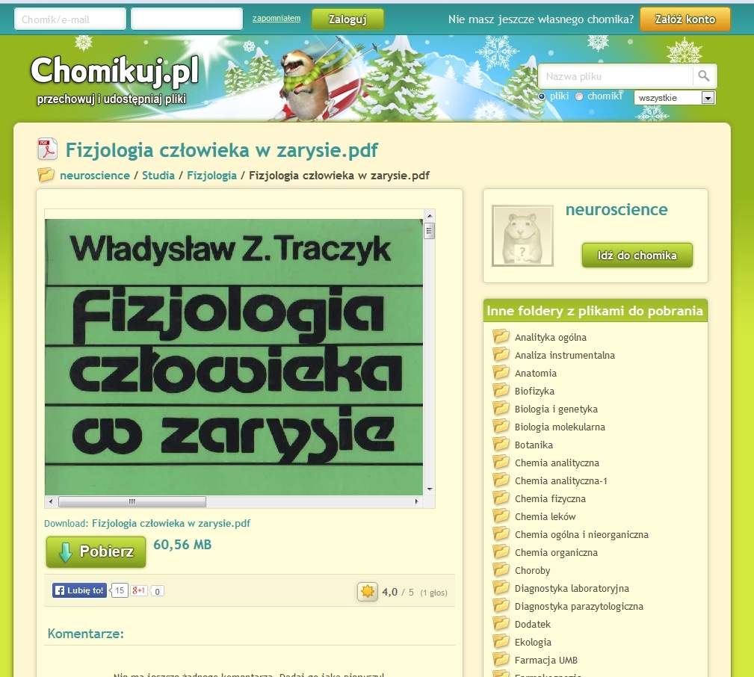
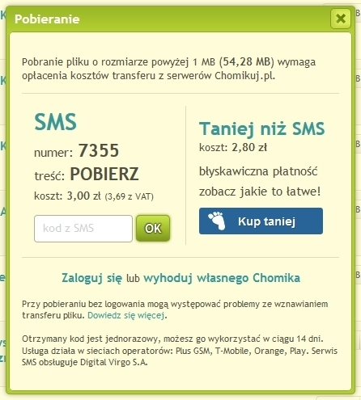

Slide 17
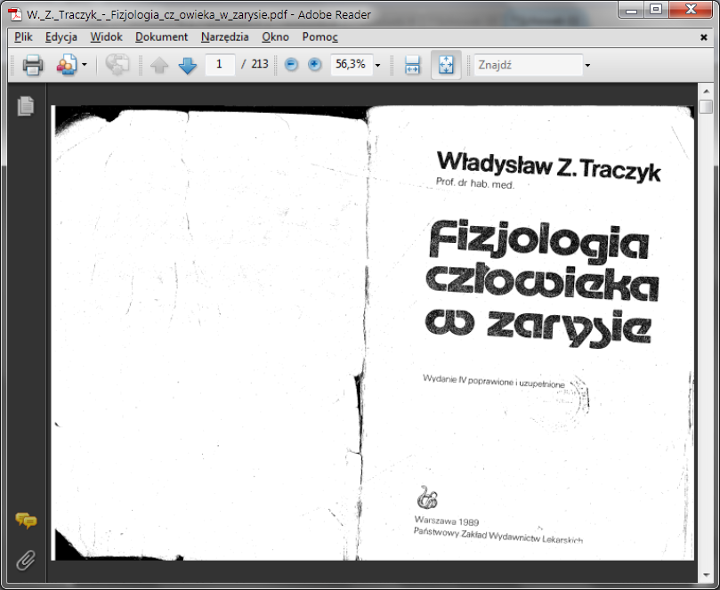
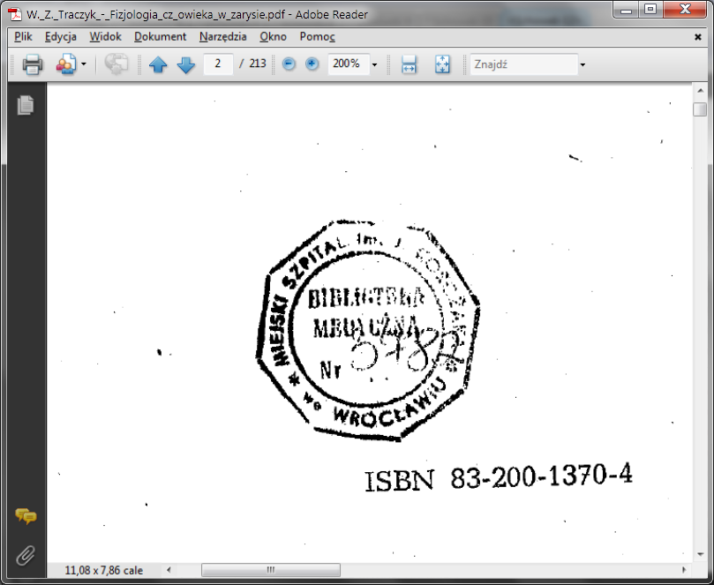
Source - Library

Slide 18
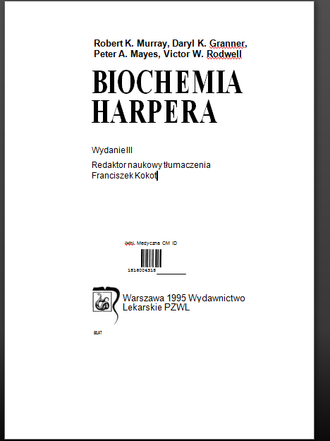
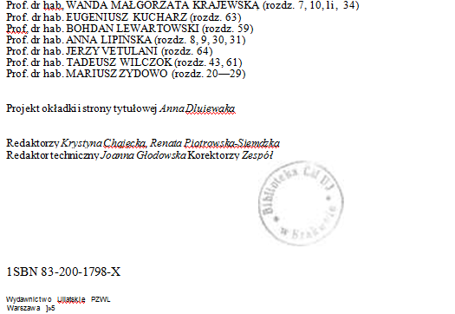
Source - Library

Slide 19
Protection ???
Fifteen years of software copy protection has taught us that, with enough motivation, any copy protection scheme - even those based on hardware - can be broken.
Digital files cannot be made uncopyable, any more than water can be made not wet.
Bruce Schneier. The Futility of Digital Copy Prevention 15.05.2001
https://www.schneier.com/crypto-gram-0105.html#3

Slide 20
How it works

Slide 21
Internet Generation
Free and immediate access
Sharing
On-line collaboration
„Open” movements and CC licence
Mobility
Where is the Library?

Slide 22
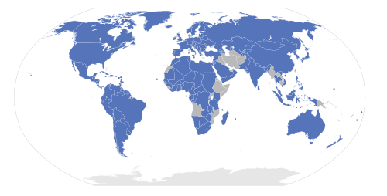
Digital Library?
Access restrictions => NO ACCESS
Public domain = Museum
Most national copyright regulations refers to Berne Convention for the Protection of Literary and Artistic Works
signed: 9 September 1886

Slide 23
The Internet is not the death of copyright, any more than radio and television were. It's just different. We need business models that respect the natural laws of the digital world instead of fighting them.
Bruce Schneier The Futility of Digital Copy Prevention
When at least forty-three million citizens download content from
the Internet, and when they use tools to combine that content in ways unauthorized by copyright holders, (..) the first question should be whether this particular prohibition is really necessary in order to achieve the proper ends that copyright law serves. Is there another way to assure that artists get paid without transforming forty-three million Americans into felons?
Lawrence Lessing, Free Culture 2004

Slide 24
How it could/should work

Slide 25
Check your local digital library
http://digitallibrary.youruniversity.edu

Slide 26
Imagine… Open Digital Library
Digital library with documents created (digitzed) by students, patrons, authors, publishers
Unrestricted and easy access to digitized books and journals (acceptable fee)
Different formats (PDF, DjVu, txt, epub, mobi… )
Business model acceptable by authors, publishers, and users

Slide 27
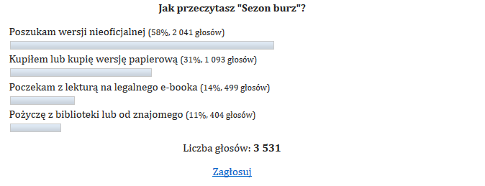
The Witcher
„I called the publisher today. We should not expect an e-book very soon. The lady I spoke to was surprised my expectation of release the paper and e-book in the same time.”
Week later an e-book (pdf, doc, rtf, epub, mobi) was avaialbe on popular websites
Nov. 2013.
Dec 5th. 2013 – Publisher has released an official e-book
http://swiatczytnikow.pl/sezon-burz-wydawnictwo-nie-chce-e-booka-fani-go-sami-zrobili/

Slide 28
Thank you
witold.kozakiewicz@umed.lodz.pl

